Slide 1
Anti-Reverse Engineering

Slide 2
Understanding Anti-Disassembly
Special code to cause disassembly analysis to produce incorrect program listings
Anti-disassembly techniques – delay/prevent analysis, increase the level of skill required of the malware analyst
Reduce the chances of malware being detected by static analysis (anti virus software)
Tricking disassembly at an incorrect offset
Jump to nonexistent target location (blank address, jump back to entry point, do this back and forth)
Flow oriented disassembly more accurate than linear disassembly – any bytes not part of the flow is not shown

Slide 3
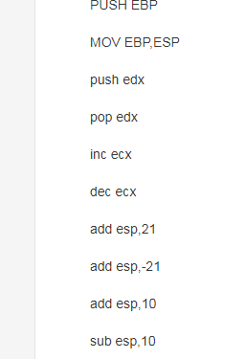
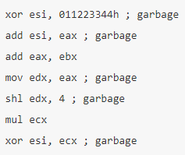
Example (will see more)
Adding Junk
Nothing changes with these steps -> can mingle these ops with other ops (or even junk)
Jmp back to original entry point

Slide 4
Defeating Disassembly Algorithms
Instructions and Data are mixed – distinguish them is hard
Two types of algorithms
Linear disassembly
Iterate over a block of code, disassembling one instruction at a time linearly
Decode blindly from start to end, ignores flow-control instructions that cause only a part of the buffer to execute
Cannot distinguish between code and data ( see examples at p331)
Embed Data between Code to confuse it (instruction/data appear to be the same)

Slide 5
Linear Disassembler
Insert a data “hello” into the instructions (“special locations”)
Disassemble bytes follow call first, then called location
Wrong
Correct using C or D keys (turn cursor into code/data)
Correct

Slide 6
Defeating Disassembly Algorithms
Flow-oriented disassembly (used by IDA Pro)
Builds list of locations to assemble by examining code from entry
(Top of p. 332) After unconditional jmp, decoding stops
(Bottom of p. 332) Linear disassembly parses ‘Failed String’ as code
Call, jmp, ret – disassemble from the “destined” location
(p. 333, 334) Instructions after call disassembled first (push hello after CALL)
Conditional jump – false branch first
Denote loc_1A
Continue till jmp
Backtracking

Slide 7
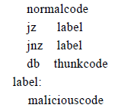
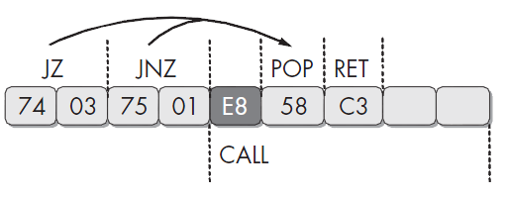
Anti-Disassembly Techniques
Fake conditionals
Back-to-back conditional jumps with the same target - jz followed by jnz should be treated as unconditional jmp
Confuses flow-disassemblers that choose fall-through path first and linear disassemblers
Disassembly does not realize it is unconditional jmp (one instr at time, not smart enough)
Usually add 0xE8 (call) to make this become calling a function
Label is 1 byte beyond 0xE8, execute call xxx in error (example 1 next)
Insert junk 0xE8 – CALL
Dissemble error

Slide 8
Call/E8 added
Example 1: 1 byte after loc_4011C4
Error from IDAPro: jump into a calling xxx
Use ‘D’ to remove the “E8” -> turn into DATA

Slide 9
Jump Instr. With a Const Cond.
xor eax, eax -> clear eax and set the zero flag (implicit)
Then jz is an unconditional jump -> zero flag is set
However, disassembler will process the false branch first -> lead to a conflict
Write 0xE9 into junk code (jmp)
Jmp will be errorneously disassembled->hide the next 4 bytes of code

Slide 10
Jump Instr. With a Const Cond.
Use D key to turn jmp (junk code) into harmless data

Slide 11
Impossible Disassembly
So far, add a byte into “strategic locations” and make the disassembler not working
This “rogue byte” is not part of the program can be thrown off by changing into Data -> “D”
What if the rogue byte is part of the program ?
Single byte is part of two instructions -> no disassembler can represent a single byte as being part of two instructions <- processor has no such limitation

Slide 12
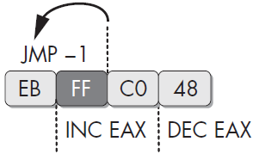
Impossible Disassembly
Impossible disassembly
Using a single byte in two instructions (rogue byte)
Any given byte may be part of multiple instructions
Disassembler limited to picking one interpretation, but processor can use both
Inward jump
FF is part of both instructions – EB FF/FF C0
INC EAX/DEC EAX – NOP sequence
Can be inserted anywhere to break the
Disassembler (no effect on the code itself)

Slide 13
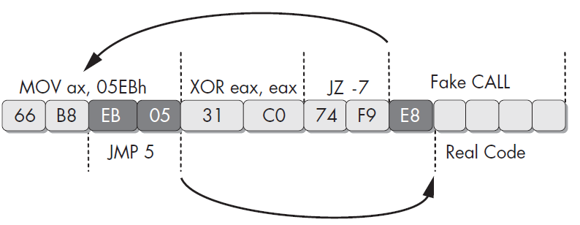
Impossible Disassembly
Mov ax, 05EBh -> populates ax register with data
Xor eax eax -> clear eax and set zero flag
Jz -7 -> unconditional jump to EB 05 -> as code means “jmp 5”
No good way to clean the code; Leave the xor eax, eax, and set the rest as data

Slide 14
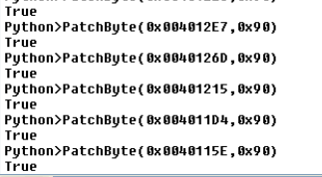
Nop-out (No operation)
Make those “rogue bytes” into NOP instructions
Use the PatchByte in IDA command line
0x90 is the NOP Op code.
Press “P” patch byte when you are done.

Slide 15
Obscuring Flow control
Function pointers
Locations resolved at run-time
Hard to statically reverse engineer
Return pointer abuse
Modify return value on stack at run-time (added a rogue retn instruction)
call $+5 coupled with rogue ret instruction on p. 342
retn makes it appear sub_4011C0 is finished, but control goes just beyond retn instruction
Real retn is not part of any function due to the rogue retn.
Notes:
A call instruction acts just like the jmp instruction, except it pushes a return pointer on the stack.

Slide 16
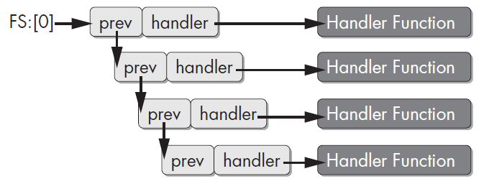
Obscuring Flow Control
Misusing structured exception handlers (SEH)
SEH allows program to handle error conditions intelligently
SEH chain maintained by a stack structure (FS segment register)
Structured Exception Handling Chain

Slide 17
Obscuring Flow Control
Example (p346 – Use Exception Handler to hide code)
Craft pointer to exception routine (0x401080) via top two instructions
Push address onto stack as exception handler in third instruction
Trigger exception (divide-by-zero).
Routine at 0x401080 is not disassembled (hide malicious code in it)
Use IDA to manually disassemble

Slide 18
Anti-Debugging

Slide 19
Anti Debugging
Anti-analysis technique for malware to recognize when it is under the control of a debugger
Slow down analysis as much as possible to increase window of vulnerability
Once found in debugger, cause a crash
Popular techniques among hundreds of techniques

Slide 20
Windows Debugger Detection
Most common way: use the Windows API
IsDebuggerPresent() returns 0 if no debugger attached by searching the Process Environment Block for field IsDebugged (next-slide example)
CheckRemoteDebuggerPresent() allows one to check the IsDebugged flag on other processes in local machine
NTQueryInformationProcess using value ProcessDebugPort to tell if a process is currently being debugged
OutputDebugString send string to debugger for display
errorValue set if no debugger attached (implicitly telling a debugger is in use)

Slide 21
IsDebuggerPresent function
Determines whether the calling process is being debugged by a user-mode debugger
Return value
If the current process is running in the context of a debugger, the return value is nonzero.
If the current process is not running in the context of a debugger, the return value is zero.

Slide 22
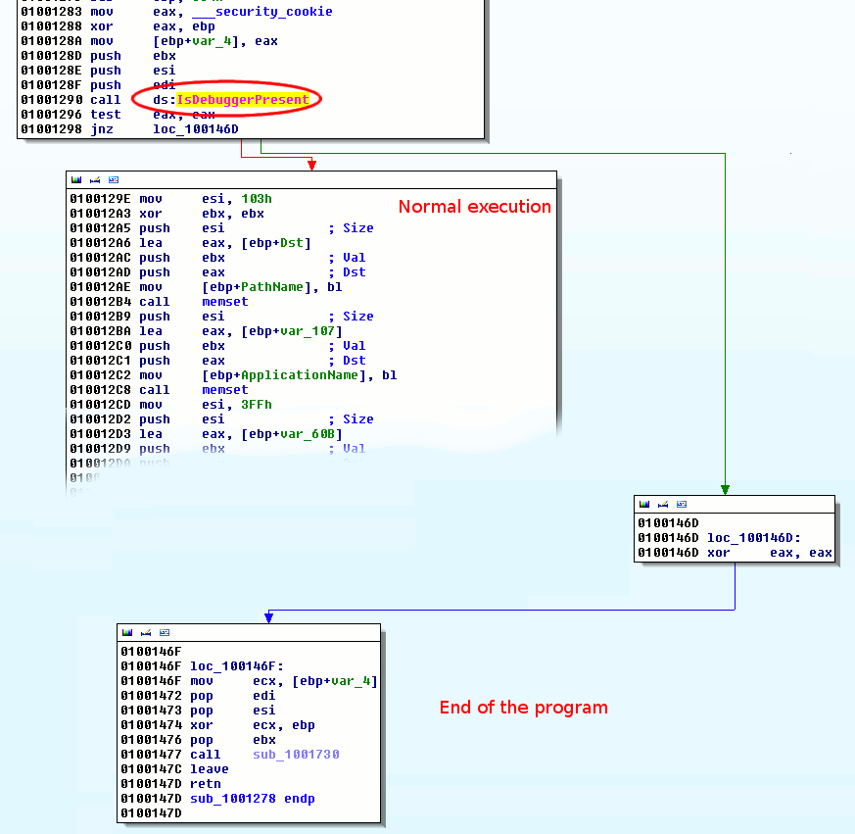
IsDebuggerPresent function

Slide 23
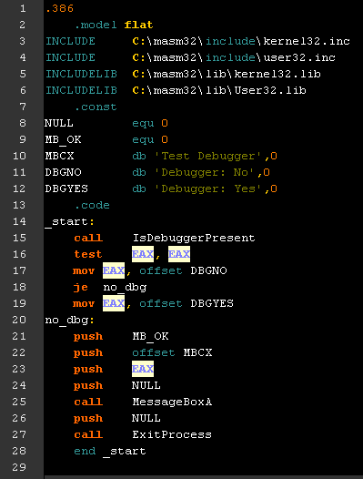
IsDebuggerPresent function
<- libs

Slide 24
IsDebuggerPresent function
<- libs
<- consts

Slide 25
IsDebuggerPresent function
<- libs
<- consts
<- EP at IsDbgPrsnt
test EAX, EAX
you can bypass it

Slide 26
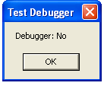
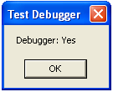
IsDebuggerPresent function
Entry-Point

Slide 27
IsDebuggerPresent function
Entry-Point
Portable Executable run

Slide 28
IsDebuggerPresent function
Entry-Point
Portable Executable run
CALL Kernel32.IsDebuggerPresent

Slide 29
IsDebuggerPresent function
Entry-Point
Portable Executable run
CALL Kernel32.IsDebuggerPresent
Test EAX, EAX
EAX == 0
EAX == 1

Slide 30
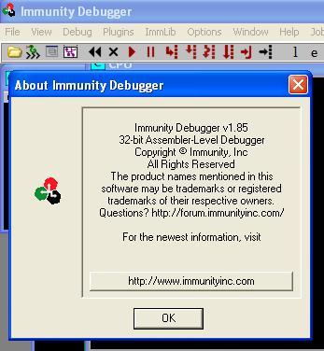
IsDebuggerPresent bypass
Debugger – Immunity Debugger (based on OllyDbg)

Slide 31
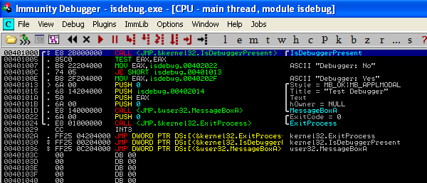
IsDebuggerPresent bypass
Run PE with the debugger

Slide 32
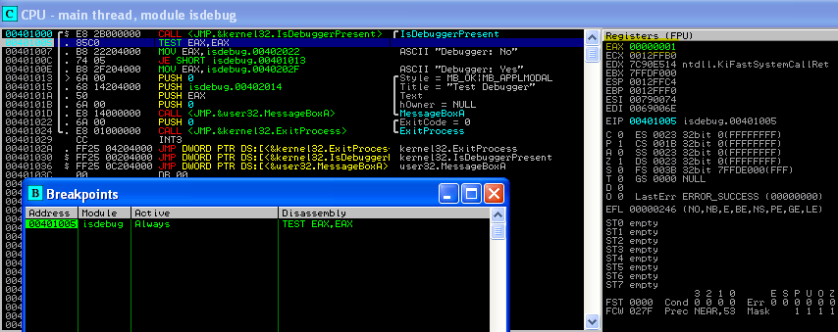
IsDebuggerPresent bypass
Breakpoint at 00401005 & run
EAX == 1

Slide 33
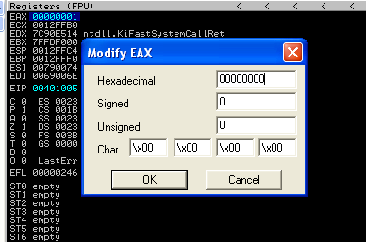
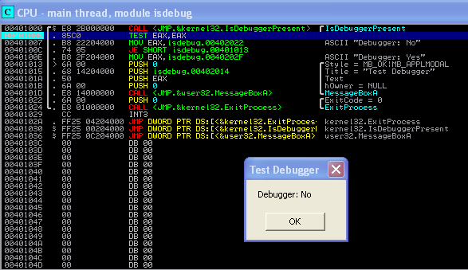
IsDebuggerPresent bypass
Change EAX value to 0
EAX == 0

Slide 34
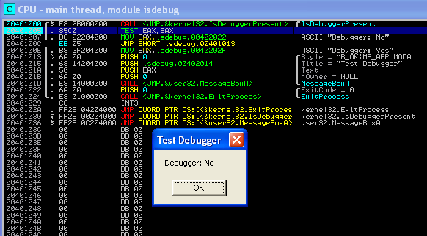
IsDebuggerPresent bypass
OR just PATCH 0040100C with JMP -> NEVER “Debugger: No” messages ^_^
go crack steam games

Slide 35
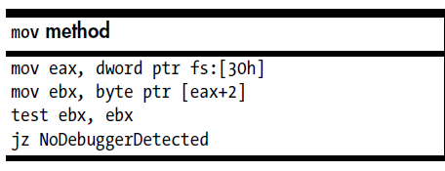
Manually Checking Structures
Manual checks of structures in memory
Most common way
Windows API may not be reliable
Bypass Windows API to check memory directly - preferred by malware
BeingDebugged flag (p. 353)
Loading of PEB (Process Environment Block) structure address fs:[30h]
Followed by access of BeingDebugged flag at offset 0x2
Check if EBX is zero, if so debugger is not attached>jmp
Hide Debugger in OllyDbg to not set the beingDebugged flag

Slide 36
Manually Checking Structures
Debugger heap check – doing something to the heap
First heap -> has a header telling whether the heap was creating within a debugger (ForceFlags/Flags)
Get address of process’s first heap (ProcessHeap) by loading value at 0x18 into PEB structure, then accessing flag field at 0x10 (XP) or 0x44 (Win7) (Listing 16-3, p. 355)
Hide-debug plug-in/manual change of ProcessHeap flag

Slide 37
Checking NTGlobalFlag
NtGlobalFlag check
Process started with a debugger creates memory heaps differently
Specified at 0x68 offset in PEB. Set to 0x70 if debugger is running
Hide-debug plug-in/manual change of flag

Slide 38
Checking for System Residue
Debugging tools also left residue on system
Manual checks of system residuals
Registry values used by debuggers (HKLM\....\AeDebug) – if set to OllyDbg (in use)
Perform FindWindow in search for debugger (e.g. Window Name OLLYDBG)

Slide 39
Identifying Debugger Behavior
INT scanning
INT 3 – software interrupt
Inserted by debugger to temporarily replace an instruction so that debug exception handler can run when software breakpoints are hit (Opcode 0xCC inserted)
Search for 0xCC in code – overcome by hardware interrupt
Performing code checksums
Malware performs checksum (CRC/MD5) on its code pages and exits if tampering detected (if 0xCC inserted, code is changed)
Timing checks
Slowdown while being debugged
Malware takes timestamps and exits if there is a lag
Especially effective when taken before & after an exception (human interventions to handle exception – delay)

Slide 40
Timing Checks
Implemented via rdtsc instruction
Count the number of ticks since the last system reboot
Store value in EDX:EAX
Execute twice, compare difference two calls – whether too large
QueryPerformanceCounter – Can use this API as well
GetTickCount – returns the number of milliseconds elapsed since last system reboot
Check to see the time increase whether you are single stepping

Slide 41
Interfering Debugger Functionality
Using TLS (thread local storage) callbacks
Execute code before entry point
Debuggers typically execute until program entry point defined by the PE header
TLS implemented in an executable contains a .tls section that can be executed before program entry point
Malware can hide functionality in TLS
Must configure debugger to pause before TLS callback code
Well-know so malware use them less frequently

Slide 42
Exceptions
Using exceptions
Debuggers typically configured to trap exceptions and not pass them through to program (can be used to detect debuggers)
Malware probes to ensure exceptions are passed through quickly
Must configure debugger to pass them to the program automatically

Slide 43
Inserting Interrupts
Inserting interrupts
Use Exceptions to annoy malware analyst
Cause debuggers to stop
Inserting INT 3 instructions or 0xCD03 (STATUS_BREAKPOINT) to generate an INT 3.
Doing the same with INT 2D (kernel debugger breakpoint)
Putting payload in interrupt handler
Having a debugger attached results in disabling malware
Make malicious code be a part of an SEH handler
INT 3 without debugger returns exception directly back into program to handle
INT 3 with debugger goes elsewhere (Listing 16-9, p. 363)

Slide 44
Debugger Vulnerabilities
PE header vulnerabilities
OllyDbg follows specifications of PE headers more strictly than Windows. Crashes on malformed headers – set size of IMAGE_NUMBEROF_DIRECTORY_ENTRIES to be more than 0x10, cause crash – same setting with Windows.
Can manually modify the field back to 0x10 using a hex editor
Set SizeofRawData to some bad values to cause crash (point to the wrong location)
Manual change back to a value close to VirtualSize

Slide 45
Anti-VM Techniques

Slide 46
Anti-VM Techniques
Virtual machines initially used only by malware analysts
Malware benefited from detecting VM (especially VMware) and shutting down to escape analysis
Normal users also use VM
Rollback recovery easy
Portability
Malware also wants to infect VMs
Anti-VM techniques become less popular

Slide 47
VM Artifacts
Process listing
3 VM processes are running – easy to see
Filesystem – VM installation directory
(e.g. C:\Program Files\VMware\VMware Tools)
Registry keys – hardware (mouse, adapters)
Networking
MAC addresses assigned for use by IEEE for VMware NICs begin with 00:0C:29 (virtual NIC)
Malware checking version of hardware, MAC
Memory (search string VMware through physical memory)

Slide 48
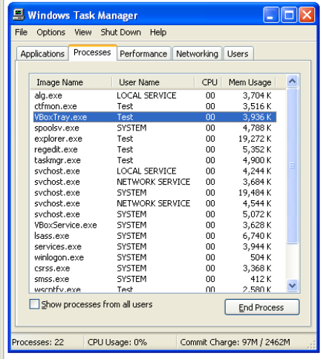
Bypassing Vmware Detection
Malware scans process list for, VMwareTray.exe – if found, jump to exit code
Counter-measures
Patch the binary to avoid the jump
Use hex editor to modify the name VMwareTray.exe so it will compare something else

Slide 49
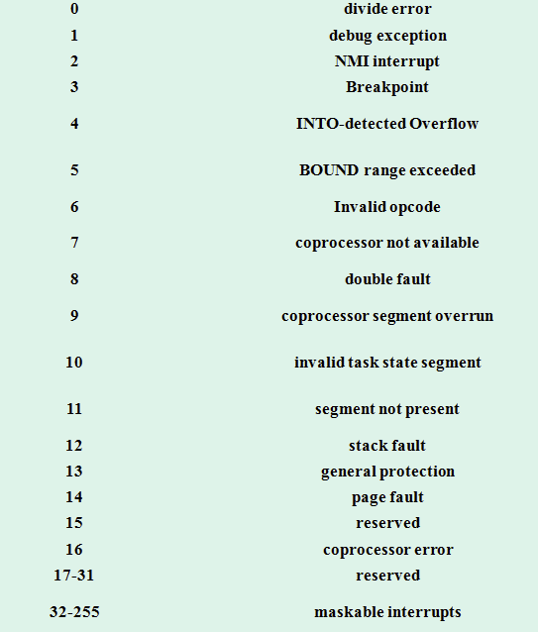
Interrupt Descriptor Table
Data structure – x86 implements an interrupt vector table
Determine the response to interrupts and exceptions

Slide 50
Vulnerable Instructions
One IDTR for VM, one for host? Conflict
VM will move the IDTR to a different memory location – check whether it is “virtual” or “physical”.
Detect VM by Descriptor Table Instructions
3 special x86 registers for pointing to machine-wide data structures
IDTR: points to Interrupt Descriptor Table Register
GDTR: points to Global Descriptor Table Register (memory lookups)
LDTR: points to Local Descriptor Table Register (unused in Windows)
Windows only uses GDT by default
Guest VM must have a different location for these tables than Host VM
VM software creates separate locations
But, Guest VM can directly execute x86 instructions that directly access underlying registers to check for inconsistency
Use these registers to detect the presence of VM (discussed next)

Slide 51
Red-Pill Anti-VM
Movie Matrix: Neo has to choose between a blue and red pill.
Blue Pill: fake reality
Red Pill: real reality (sidt –store interrupt descriptor table register in a new destination operand)
x86 instruction sidt loads value of IDTR
Virtual machine monitor must relocate the guest IDTR to avoid conflict with host IDTR
Check if VM runs the sidt instruction
Cmp al, 0FFh -> the VM signature
Only works on single-processor machine – multi-core processor each processor has an IDT so Red Pill is not reliable
Recall LDT is not really used by Windows but the VM (no pill technique)
Check sldt against zero, if value is set, VM is in use
Disable Acceleration on VMware

Slide 52
Querying I/O port
VMware virtualizes I/O ports – weakness
Communication between guest OS and host.
Check virtual I/O port is working? Use the in (0xED) instruction.
in 0xED - Copies data from I/O port from source operand to a memory location.
Capture I/O destined for the communication channel port 0x5668 (VX)
Magic number 0x564D5868 (VMXh) – EAX register is loaded with magic number; ECX loaded with action you want to perform – 0xA – get Vmware version type; 0x14 will get memory size. ECX will contain the VM type
Must NOP out the in checks
Common Anti-VM instructions
sidt, sgdt, sldt, smsw, str, in, cupid – replace by NOP
Pactching the binary to avoid calling these instructions
Use Multiprocessor (multiple IDTR) – Red Pill Test work for single processor
20 instructions designated by VMware as “not virtualizable”
Malware will only use them if checking for VMs

Slide 53
VM Escape
Exploiting VMware bugs to crash host or run code in it
Prior exploits (now patched) include shared folder feature, drag-and-drop functionality in VMware Tools, shared clipboard, VM display function (Cloudburst)
Guest can write to any file on the host - disable shared folder
VM display function – patched by VMware

